Slide 1
Chapter 5 Conceptualization, Operationalization, and Measurement

Slide 2
Chapter Outline
Introduction
Measuring Anything That Exists
Conceptualization
Definitions in Descriptive and Explanatory Studies
Operationalization Choices
Criteria of Measurement Quality
The Ethics of Measurement
Chapter Summary
Questions

Slide 3
Measuring Anything That Exists
Observation versus Measurement
Measurement
Careful, deliberate observations
of the real world for the purpose of describing objects and events in terms of the attributes composing the variable.

Slide 4
Measuring Anything That Exists
How would you measure…
political party affiliation?
age?
grade point average?
religious affiliation?

Slide 5
Measuring Anything That Exists
How would you measure…
prejudice?
compassion?

Slide 6
Measuring Anything That Exists
Direct Observables
Things we observe ourselves (e.g. color of the desk)
Indirect Observables
Things we’re not around to see, but can infer from something that is observable (e.g. gender, from a checkmark on a questionnaire next to “female”)
Constructs
Theoretical creations, not observed directly or indirectly but having agreed upon meanings (e.g. intelligence)

Slide 7
Measuring Anything That Exists
Concepts
constructs derived by mutual agreement from mental images.
Conceptions
our individual understandings of seemingly related observations and experiences
Conceptualization

Slide 8
Conceptualization
Conceptualization
process of specifying what we mean (agreeing upon a meaning. terms) for a concept in research.
We cannot meaningfully answer a question without a working agreement about the meaning of the outcome.

Slide 9
Conceptualization
How would you conceptualize…
prejudice?
compassionate?

Slide 10
Conceptualization
Indicators and Dimensions
Indicator
An observation we choose as a reflection of a concept/construct/variable
Dimension
A grouping of a concept/construct/variable.
Multiple indicators can make up a single dimension (amongst multiple dimensions) of a concept/variable

Slide 11
Conceptualization
Indicators and Dimensions of Religiosity

Slide 12
Conceptualization
Identify appropriate indicators and dimensions for…
college success
political activity
poverty
binge drinking
fear of crime

Slide 13
Conceptualization
The Interchangeability of Indicators
If several indicators accurately represent the same concept, all of them should reach the same result.
Can use different subsets of indicators to accurately measure the concept

Slide 14
Conceptualization
Operational Definition
specifies precisely how a concept will be measured – that is, the operations we will perform.

Slide 15
Conceptualization
Conceptualization – Practice
Anomie

Slide 16
Conceptualization
Definitions can be problematic
Unemployment rate
Who is employed?
Who is in the labor force?
What do other definitions include?

Slide 17
Operationalization Choices
Conceptualization versus Operationalization Processes
Operationalization
defining measurement procedures to represent concepts
Range of Variation
Trying to study all aspects/levels of a concept

Slide 18
Operationalization Choices
Precision
deciding how precise/fine-grained to be in your measurement

Slide 19
Operationalization Choices
Attributes
characteristic or quality of something (ex: female, old, student)
Variable
logical set of attributes (ex: gender, age)
Defining Variables and Attributes
The attributes composing variables should be exhaustive.
Attributes must be mutually exclusive.

Slide 20
Operationalization Choices
How can we operationally define ____ (both exhaustive and mutually exclusive)?
Party Affiliation

Slide 21
Operationalization Choices
Levels of Measurement
Nominal
Ordinal
Interval
Ratio

Slide 22
Operationalization Choices
Nominal
Variables whose attributes have only the characteristics of exhaustiveness and mutually exclusiveness. Simple categories. Attributes that classify, but cannot be ranked!
Examples: gender, religious affiliation, college major, hair color, birthplace, nationality, party affiliation

Slide 23
Operationalization Choices
Ordinal
Variables with attributes we can logically rank order. Variables whose attributes that classify and can be ranked but lack an associated numerical value.
Examples: socioeconomic status, level of conflict, prejudice, conservativeness, hardness

Slide 24
Operationalization Choices
Interval
Variables for which the actual distance between attributes has meaning. Variables whose attributes classify, can be ranked ordered, and have an equal numerical distance between values.
Examples: temperature (Fahrenheit), IQ score

Slide 25
Operationalization Choices
Ratio
Variables whose attributes meet the requirements of a interval measure, and has a true zero point.
Examples: temperature (Kelvin), age, length of time, number of organizations, number of groups, number of A’s received in college

Slide 26
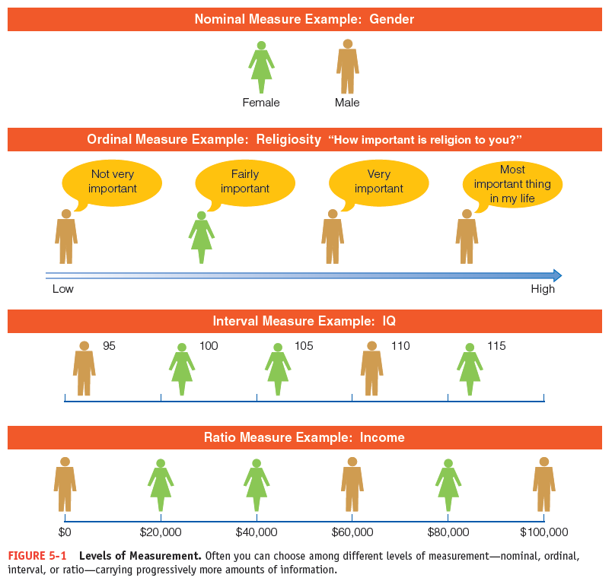
Figure 5-1
Levels of Measurement
Often you can choose among different levels of measurement—nominal, ordinal, interval, or ratio—carrying progressively more amounts of information.

Slide 27
Operationalization Choices
Implications of Levels of Measurement
some analyses require minimum levels of measurement
some variables can be treated as multiple levels of measurement
Single or Multiple Indicators

Slide 28
Operationalization Choices
How can we measure _____ at multiple levels?
Age
Income

Slide 29
Criteria of Measurement Quality
Precision and Accuracy
precise measures are superior to imprecise ones.
Reliability
same data would be collected/same results would occur in repeated observations of the same phenomenon.

Slide 30
Criteria of Measurement Quality
Test-Retest Method
making the same measurement more than once.
Split-Half Method
multiple sets of randomly assigned variables should produce the same classifications
Established Measures
Reliability of Research Workers

Slide 31
Criteria of Measurement Quality
Validity
measurement that accurately reflect the concept it is intended to measure.
Face Validity
measurement that seems to make reasonable sense
Criterion-Related Validity
measurement related to some external criterion

Slide 32
Criteria of Measurement Quality
Construct Validity
the degree to which a measure relates to other variables as expected within a system of theoretical relationships.
Content Validity
measure that covers the range of meanings included within a concept.

Slide 33
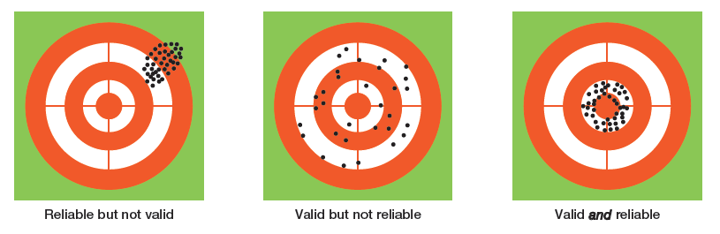
Figure 5-2
An Analogy to Validity and Reliability
A good measurement technique should be both valid (measuring what it is intended to measure) and reliable (yielding a given measurement dependably).

Slide 34
The Ethics of Measurement
Conceptualization and measurement must not be guided by bias or preferences for particular research outcomes

Slide 35
Chapter Summary
Explain and illustrate how conceptions, concepts, and constructs relate to reality.
Describe the steps involved in the process of conceptualization.
Discuss the assertion that definitions are more critical in descriptive than in explanatory studies.

Slide 36
Chapter Summary
Identify and illustrate the many choices you may have in operationalizing variables.
Distinguish among precision, accuracy, reliability, and validity and discuss how they affect the quality of a measurement technique.
Explain how measurement decisions can have ethical implications.

Slide 37
Questions

Slide 38
Question 1
It is truly possible to measure the stuff of life.
True
False

Slide 39
Question 2
_____ refer to mental images.
Perspectives
Theories
Conceptions
Methods

Slide 40
Question 3
The mental processes whereby fuzzy and imprecise notions are made more specific and precise is called:
construction
reification
conceptualization
operationalization

Slide 41
Question 4
Which of the following are examples of nominal measures?
gender
religious affiliation
political party affiliation
birthplace
all of the above

Slide 42
Question 5
_____ is the degree to which a measure covers the range of meanings included within a concept.
Construct validity
Criterion-related validity
Face validity
Content validity

Slide 43
Question 6
In social research, the process of coming to an agreement about what terms mean is:
hypothesizing
conceptualization
variable determination
operationalization

Slide 44
Question 7
The _____ of concepts in scientific inquiry depends on nominal and operational definitions.
specification
interchangeability
functioning
network

Slide 45
Question 8
A level of measurement describing a variable whose attributes are rank-ordered and have equal distances between adjacent attributes are _____ measures.
ratio
interval
nominal
ordinal

